Slide 1
Chapter VI.
Boot Process and system Monitoring
LINUX AND OPEN SOURCE SOFTWARE
Department of Computer Engineering and Electronics

Slide 2
Main contents
Boot Loading Process
Console-Based Monitoring
Graphical Process and System-Management Tools

Slide 3
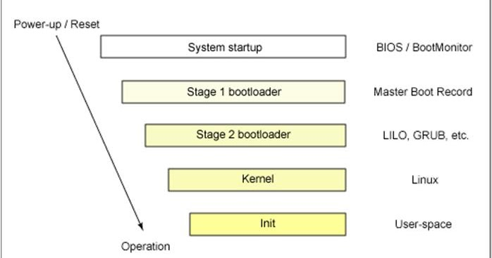
Boot Loading Process
There are 4 phases to starting up the system:
  BIOS
  Boot loader
  Kernel
  Upstart (which manages system tasks and services are configured at /etc/init)

Slide 4
Boot Loading Process
﻿BIOS
When the computer begins execution, it starts by executing this code, which is also called the firmware, as it is normally stored in a permanent form of memory, such as ROM, on the computer's motherboard.
This code must initialize the hardware on the motherboard other than the CPU, and obtain the code for the next step, the boot loader. Modern computers provide several possibilities for the boot loader and the choice is normally set on the BIOS startup screen.
﻿The BIOS gets the system ready to load and run the software that we recognize as the operating system. As a last step, the BIOS code looks for a special program known as the boot loader or boot code.

Slide 5
Boot Loading Process
﻿Boot Loader
A boot loader stored in the first sector of a hard disk, the Master Boot Record, or MBR. This may be GRUB or LILO or yaboot or others.
A boot loader stored on some other storage device, such as a CDR or USB flash drive.
A boot loader which uses the network, such as the Pre-Execution Environment (PXE). This code is normally stored on a ROM on the networking card itself.
The need for the initial parts of the bootloader code on the first part of a storage medium explains why some hard drives are 'bootable' and others are not.
﻿If the BIOS detects a hardware problem, the boot process fails, and the BIOS generates a few beeps from the system speaker.

Slide 6
Boot Loading Process
﻿Boot Loader
The MBR contains the boot loader code and the partition table.
It only requires 4096 Bits of storage to store the GRUB and Linux booting files inside the MBR partition. The GPT partitioning scheme replaces the MBR table in the modern era.
﻿Unified Extensible Firmware Interface (UEFI) ﻿serves a similar role to BIOS and has replaced BIOS in most modern systems. For most end users, the difference is negligible, except that if you have a UEFI computer, you may need to do some research to install Ubuntu.
﻿The boot loader locates the Linux kernel on the disk and loads it into memory. After that task is completed, the boot loader passes control of the system to the Linux kernel.

Slide 7
Boot Loading Process
﻿Loading Linux Kernel
﻿Kernel manages the system resources.
﻿Linux refers to each application as a process, and the kernel assigns each process a number called a process ID (PID).
﻿Traditionally, the Linux kernel loads and runs a process named init, (e.g., ﻿SysVinit). ﻿Then it starts every subsequent process.
init has been replaced by newer options such as Upstart then ﻿systemd in Ubuntu. ﻿systemd is the mother of all processes and is responsible for bringing the Linux kernel up to a state where work can be done.
﻿systemd starts by mounting the file systems that are defined in /etc/fstab
﻿systemd configuration file at /etc/systemd/system/default.target

Slide 8
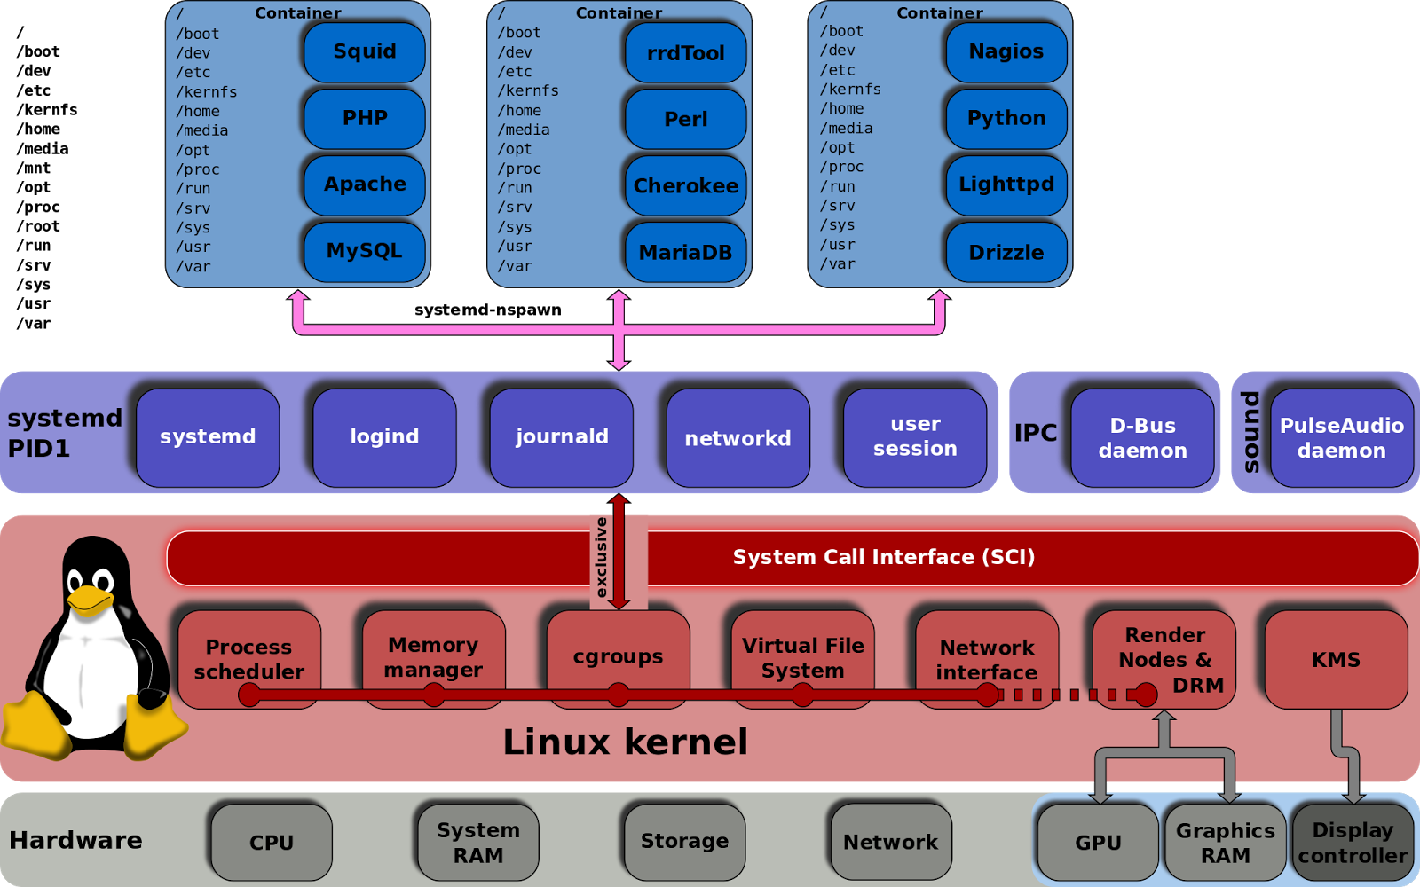
Boot Loading Process
﻿Loading Linux Kernel
https://www.techsupportpk.com/2015/05/linux-systemd-essentials-working-with-services-units-and-the-journal.html

Slide 9
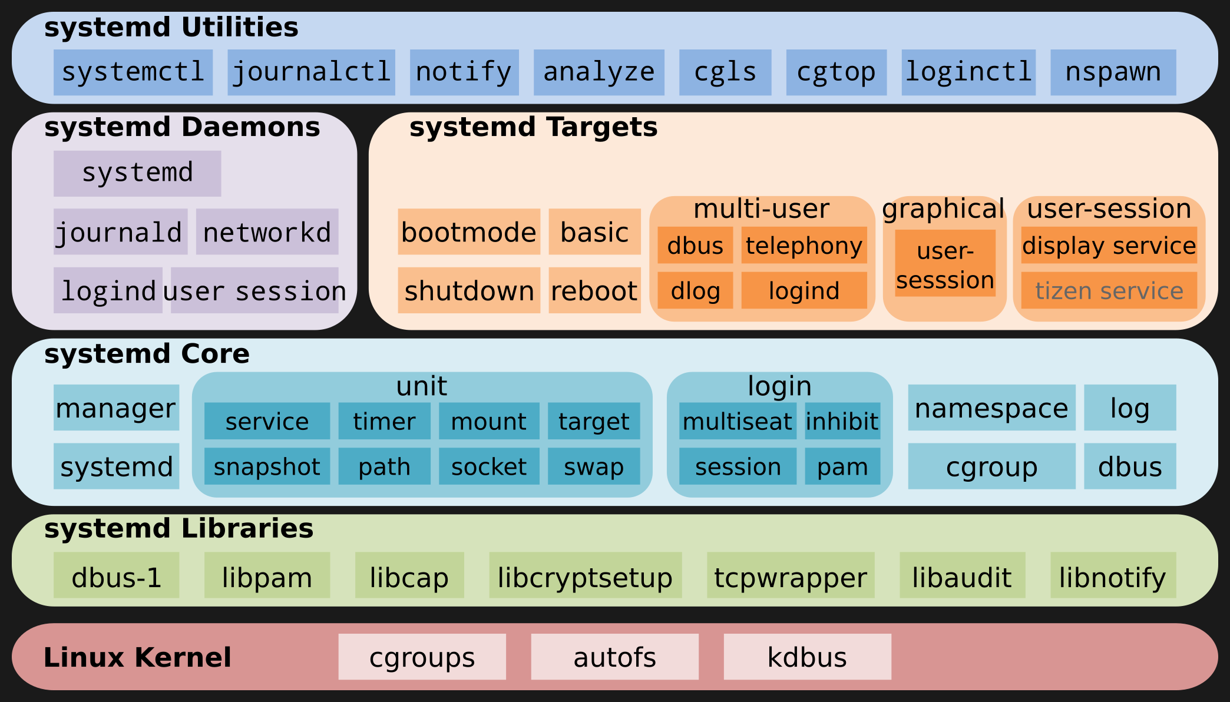
Boot Loading Process
﻿Loading Linux Kernel
https://www.techsupportpk.com/2015/05/linux-systemd-essentials-working-with-services-units-and-the-journal.html

Slide 10
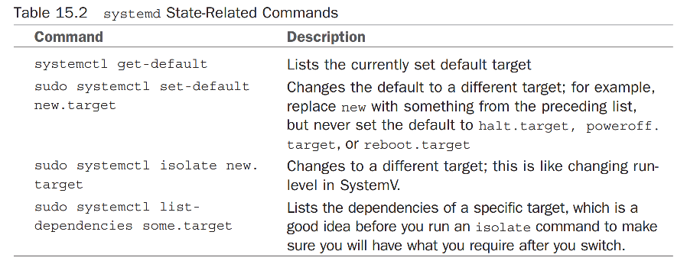
Boot Loading Process
Running Services in Boot Process
﻿After the base services are loaded and running, systemd will also load any user-defined services. All of these services are called units. To list every available unit file on your system, use
$ systemctl list-unit-files

Slide 11
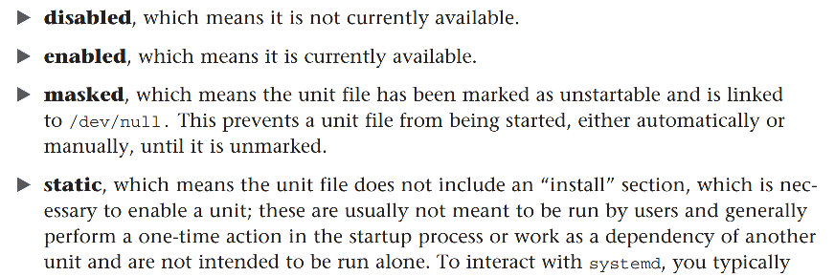
Boot Loading Process
Running Services in Boot Process
$ systemctl list-unit-files

Slide 12
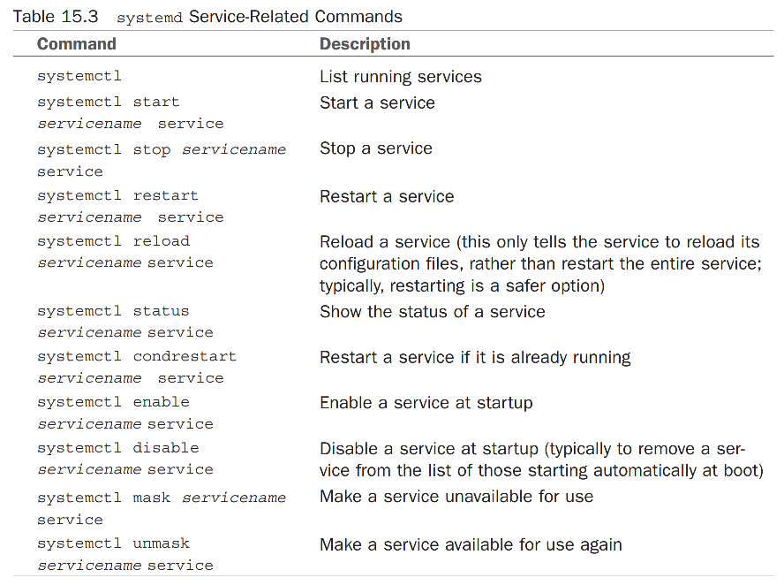
Boot Loading Process
Running Services in Boot Process

Slide 13
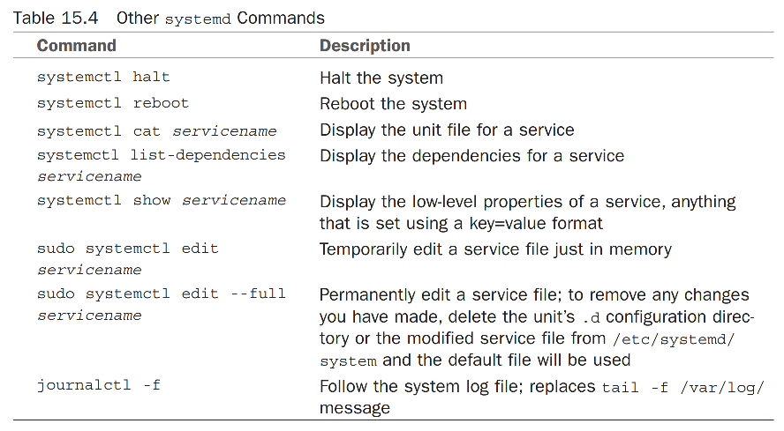
Boot Loading Process
Running Services in Boot Process
We use graphical configuration: ﻿ Startup Applications Preferences in Ubuntu

Slide 14
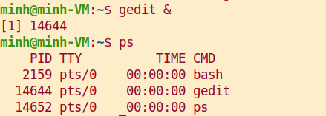
Console-Based Monitoring
﻿Through the /proc file system, you can communicate directly with the kernel to get a deep view of what is currently happening.
﻿Developers tend to use the /proc file system as a way of extracting information from the kernel and for their programs to manipulate that information into human-readable formats.
﻿Whenever an application or a command is launched, either from the command line or a clicked icon, the process that comes from the kernel is assigned an identification number called a process ID (PID).

Slide 15

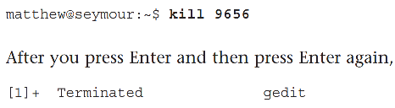
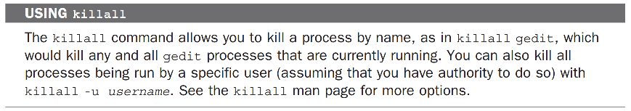
Console-Based Monitoring

Slide 16
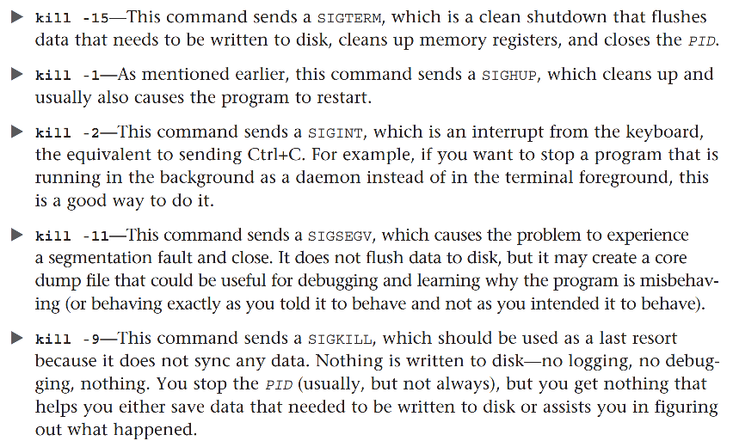
Console-Based Monitoring

Slide 17
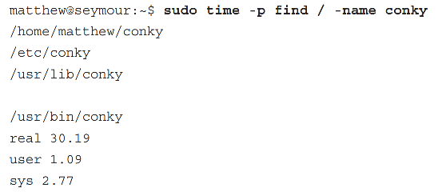
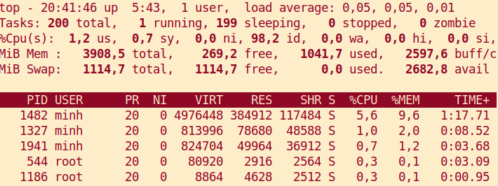
Console-Based Monitoring
top and htop commands ﻿for monitoring resource usage

Slide 18
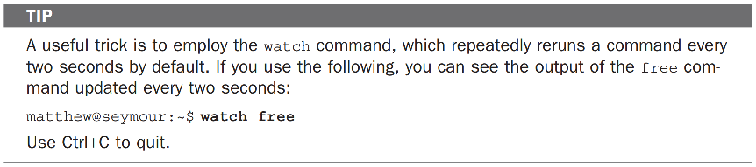
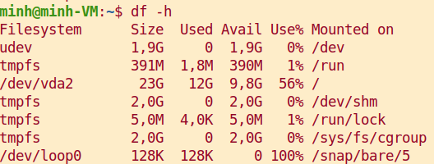
Console-Based Monitoring
free command ﻿utility displays the amount of free and used memory in the system, in kilobytes
df command

Slide 19
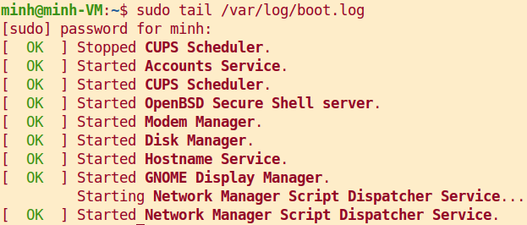
Console-Based Monitoring
Checking Log Files
﻿Most log files can be found in /var/log/ or its subdirectories.

Slide 20
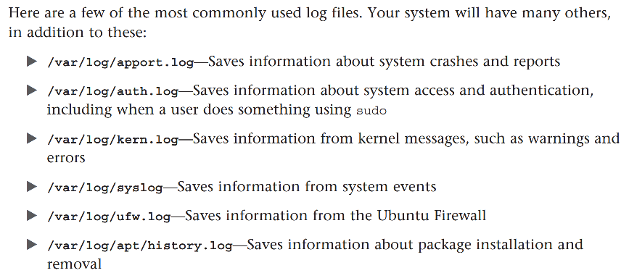
Console-Based Monitoring
Checking Log Files
﻿Most log files can be found in /var/log/ or its subdirectories.

Slide 21
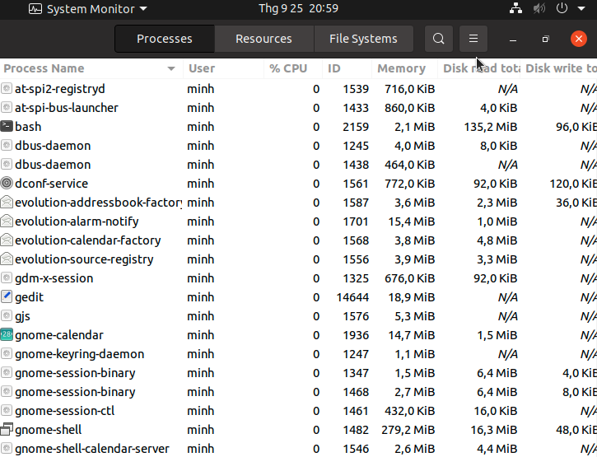
Graphical Process and System-Management Tools
System Monitor

Slide 22
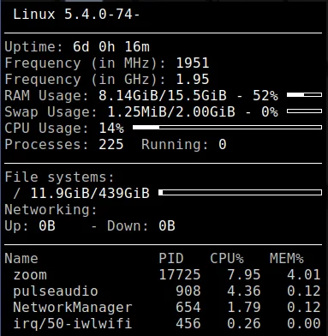
Graphical Process and System-Management Tools
Conky

Slide 23
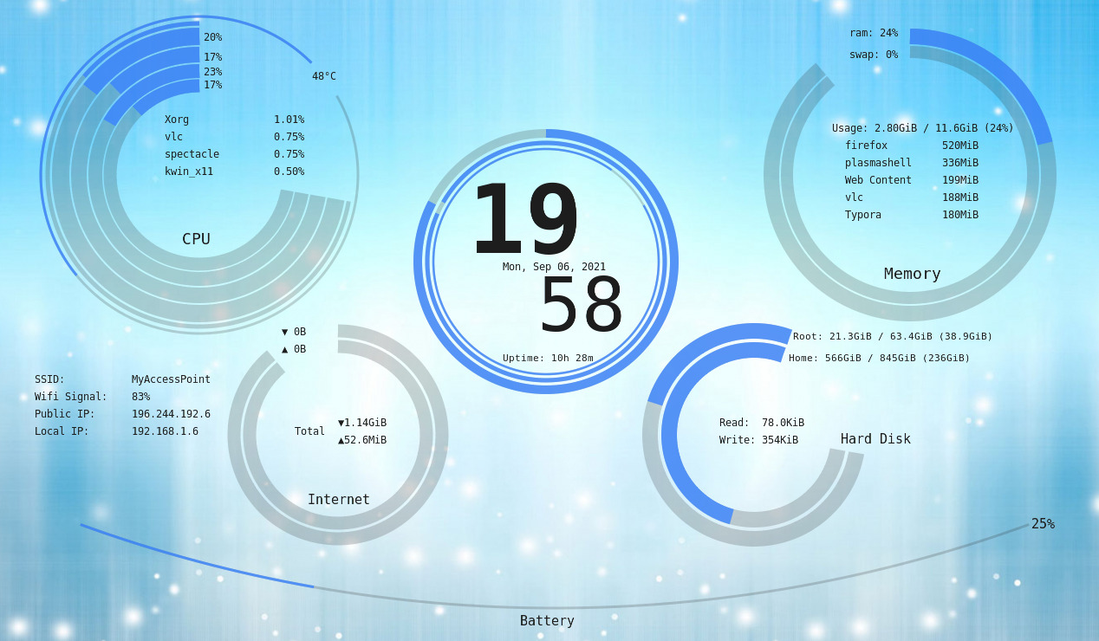
Graphical Process and System-Management Tools
Auzia Conky

Slide 24
Graphical Process and System-Management Tools
﻿Enterprise Server Monitoring
﻿﻿Servers used in enterprise situations require extreme uptime. Monitoring is vital to know how your system is performing and to have observability into the general health of your system components and services.
Some enterprise tools
  Datadog
  ﻿Nagios
  ﻿New Relic
  ﻿SignalFx
  ﻿Splunk
  ﻿Zabbix

Slide 25
Remarks
Remarks:
  This lecturer provides fundamentals of boot process
  Review chapter 15, 16 in textbook
  Practice with example commands and tools

